Slide 1
Network Intrusion Detection
Anomalous
Rhadey Shyam, Joseph Wang, Wanda Wang, Ho Fai Wong
June 26, 2016

Slide 2
Introduction
Task:
Build a predictive model capable of distinguishing between benign and malicious network connections (i.e. network attacks)
Balance model accuracy with interpretability and resource consumption
Background:
MIT’s Lincoln Laboratory set up an environment to acquire nine weeks of raw TCP dump data for a local-area network (LAN) simulating a typical U.S. Air Force LAN
They operated the LAN as if it were a true Air Force environment, but peppered it with attacks falling into four main categories:
DOS: Denial of Service
R2L: Remote to Local
U2R: User to Root
Probing: Surveillance
The data used for this analysis was provided by the Information Security Centre of Excellence (ISCX): http://www.unb.ca/research/iscx/dataset/iscx-NSL-KDD-dataset.html
Notes:
Software to detect network intrusions protects a computer network from unauthorized users. A connection is a sequence of TCP packets starting and ending at some well defined times, between which data flows to and from a source IP address to a target IP address under some well defined protocol. Each record contained values of 41 variables
DOS: denial-of-service, e.g. syn flood
R2L: unauthorized access from a remote machine, e.g. guessing password
U2R: unauthorized access to local superuser (root) privileges, e.g., various ``buffer overflow'' attacks
Probing: surveillance and other probing, e.g., port scanning.
In recent year, due to the growing use of smart devices and the Internet, network traffic is rapidly increasing. A Cisco report found the following : “Global IP traffic in 2012 stands at 43.6 exabytes per month and will grow threefold by 2017, to reach 120.6 exabytes per month” [1]. Intrusions are defined as attempts or action to compromise the confidentiality, integrity or availability of computer or network [2]. Intrusion detection systems (IDSs) are software or hardware systems that automate the process of monitoring the events occurring in a computer system or network, analyzing them for signs of security problems
Why bother detecting intrusions if you’ve installed firewalls, patched operating systems, and checked passwords for soundness? The answer is simple: because intrusions still occur. Just as people sometimes forget to lock a window, for example, they sometimes forget to correctly update a firewall’s rule set. Even with the most advanced protection, computer systems are still not 100% secure [1] The goal of intrusion detection system is to detect intrusions. Intrusion detection systems (IDS) have emerged to detect actions which endanger the integrity, confidentiality or availability of a resource as an effort to provide a solution to existing security issues.

Slide 3
Data Exploration

Slide 4
About the data
Data size:
41 features
125,973 connections in Train
22,543 connections in Test
Connection types:
Train data has 46.5% malicious connections (i.e. attacks) and 53.5% normal connections
We are interested in classifying connections as either normal (0) or abnormal (1), and not specific attack types
Features summary:
6 Binary (e.g. is_host_login)
3 Nominal/Character (protocol_type, service, flag)
32 Continuous
High level categories of variables:
Basic features of individual TCP connections
Content features within a connection suggested by domain knowledge
Traffic features computed using a two-second time window
Notes:
Breakdown by Protocol Type
48% TCP connections are abnormal
17% UDP connections are abnormal
84% ICMP connections are abnormal
(IJARCCE%2096.pdf)
Dummified
nrow(select(new.KDD.train, tcp, outcome.response)%>% filter(., tcp==1) %>% filter(., outcome.response==1))
#[1] 49089
#49089/102689 = 0.48%
nrow(select(new.KDD.train, tcp, outcome.response)%>% filter(., tcp==1))
#[1] 102689
High level categories of variables:
Basic connection info
Content-based
Connection-history based

Slide 5
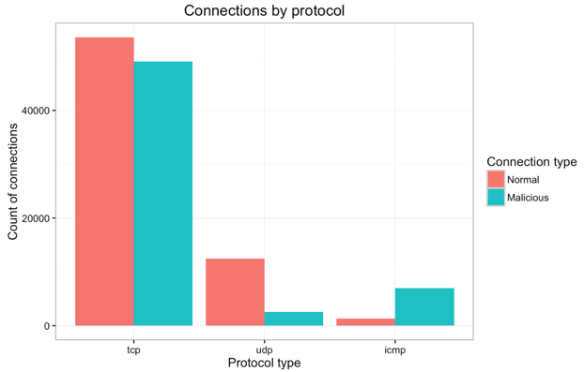
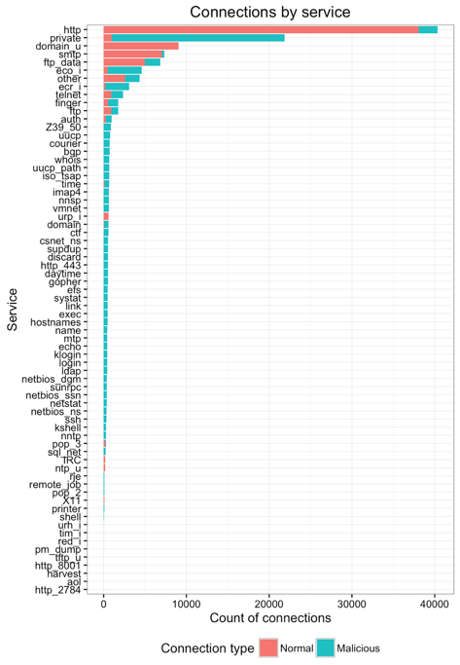
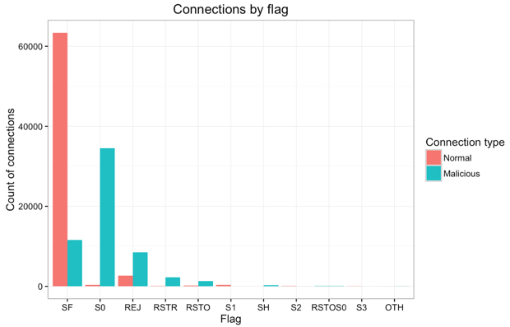
Initial data exploration

Slide 6
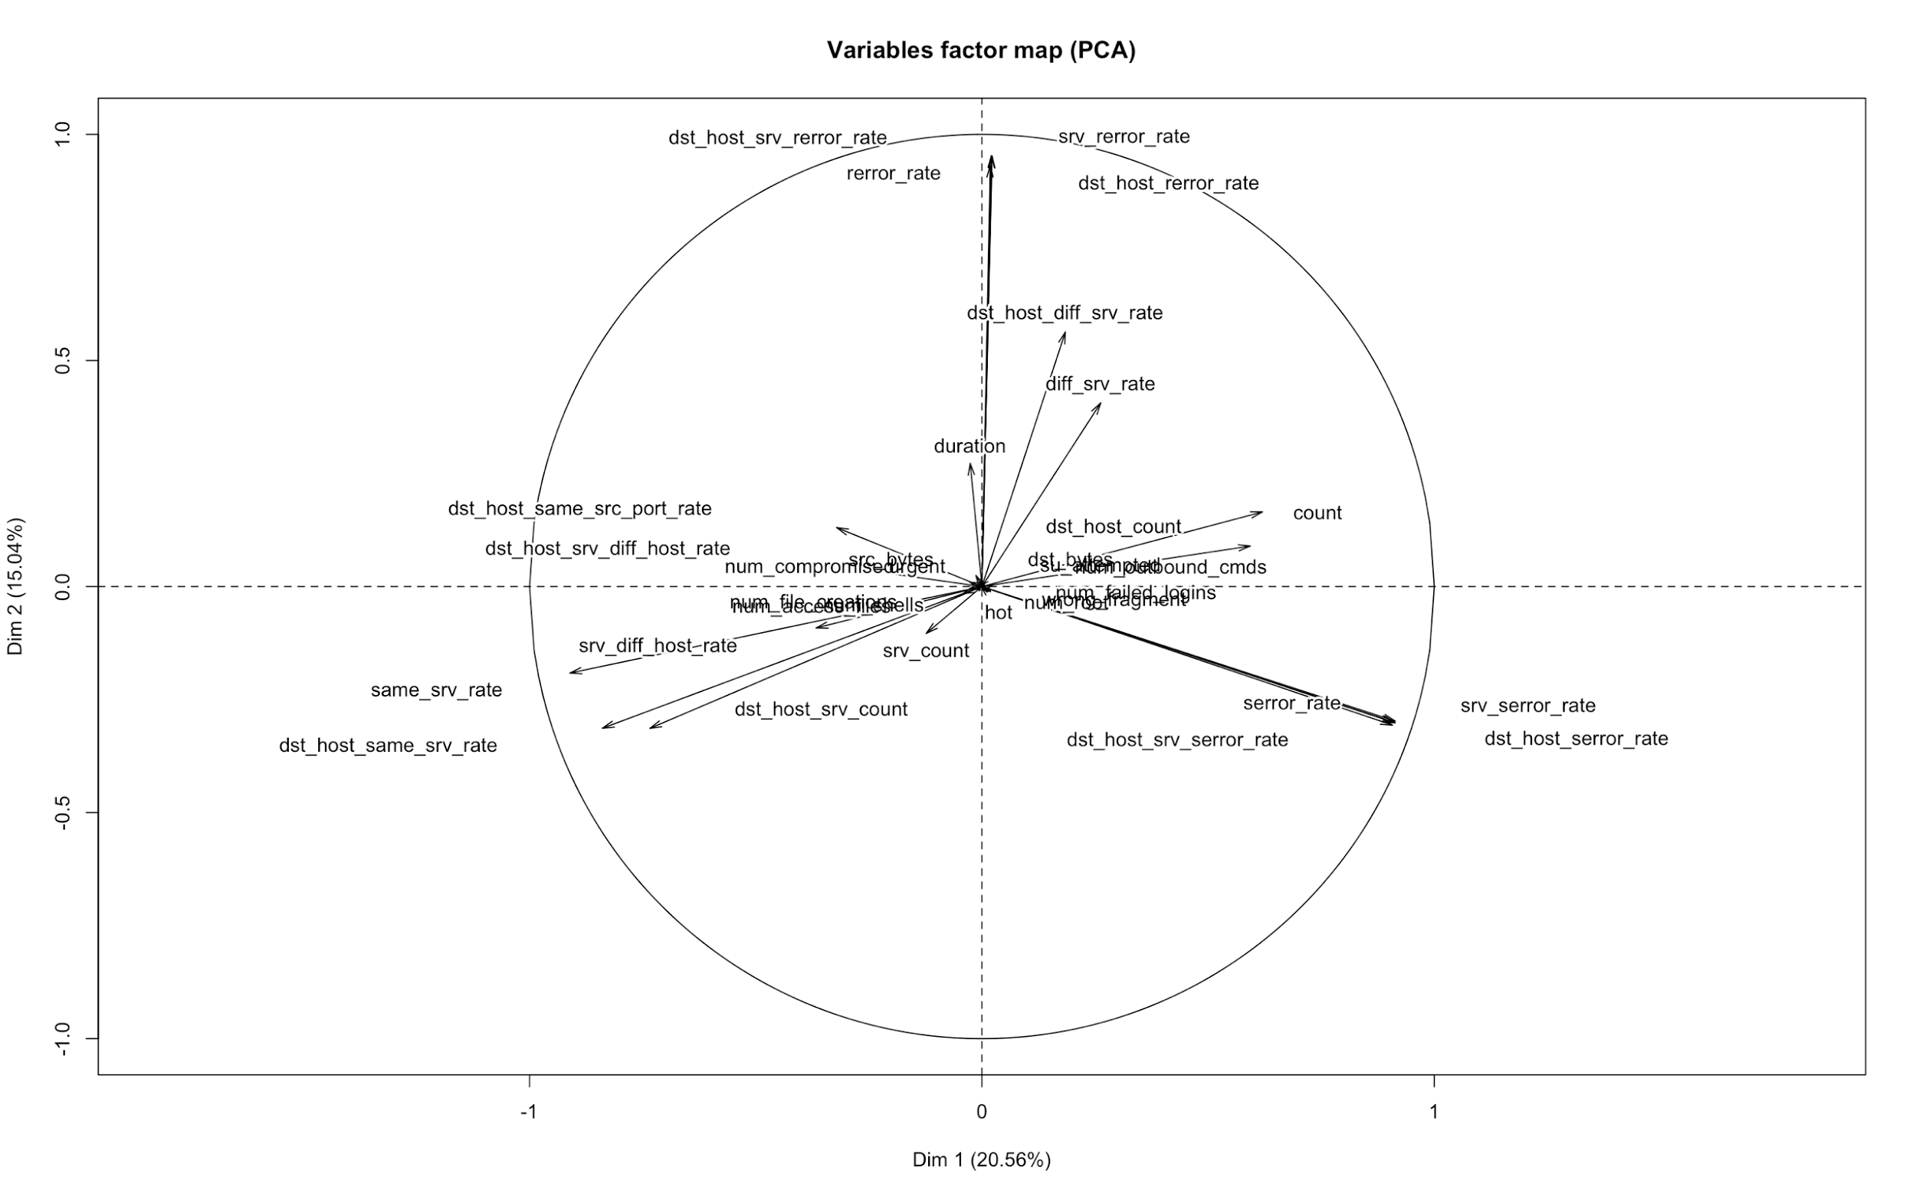
PCA on continuous variables
REJ TCP errors
Connections to different services for same hosts
Count of connections between same hosts
Connections to same services for same hosts
SYN TCP errors
Notes:
Call out that same_srv_rate and diff_srv_rate should be complementary but aren’t

Slide 7
K-Means Clustering
Approach: Connections were labeled based on the 4 attack types, including normal connections, and are clustered based on commonalities amongst shared features.
Goal is to perceive real-world attack patterns or scenarios through a clustering-based approach.
Cluster Description (30 Clusters, arbitrary thresholds):
Normal is the dominant label (>60%) along with heterogeneous attack types (5 clusters)
Normal dominance (>95%) (10 clusters)
Heterogeneous attack types, where normal is negligible (0-6%) (12 clusters)
Heterogeneous attack types where Normal is non-dominant (>6%) (2 clusters)
Objective: Desired algorithm should be able to classify malicious attacks successfully
Algorithm likely able to detect abnormal connections
More difficult for algorithm to identify a very small population of attacks
Clusters contain mostly attacks; very small amount of normal connections risk misclassification
Greater number of normal connections could be misclassified in these clusters
*Heterogeneous (Probe, DOS, r2l)
Notes:
k-means clustering methods were used to roughly detect unknown attack patterns, descriptive purpose only
Arbitrally different thresholds, normal is dominate, large variance due to the malicious attacks, alogrothim can probalby detec.
Normal dominant is tougher to detect, algo think its normal, how to detect 5% harmful, more difficult to identify
2) quite dangerous, if aiming for good network security, hard to carve out
3)easy to classify, more normal connections filtered out
4) easy to identify as attacks, very ittle conhetergenous, easy for us to detect, normal is negligble, large part will be malicious, some connection will be dropped but not much
Quick hit for our algos.
Description:
Heterogeneous attack types(Probe and/or DOS), where Normal is the dominant label (>60%)
Cluster 16: 71% Normal, 29% Probe attack type
Cluster 25, 21: 85-88% Normal, 10 to 12% DOS, 3% Probe attack type
Cluster 0, 10: 61-74% Normal dominance, 26 to 35% r2l attack type
Normal dominance (>95%) ; A third of the clusters
Cluster 2,3,5,6,9,11,14,20,22,27: Normal dominance
3) Heterogenous (DOS and/or Probe), where normal is negligible (0-6%)
Cluster 26: DOS dominance (100% teardrop) attack type, no normal
Cluster 4,8,23: Probe dominance w/ normal; Cluster 7, 13 :Purely Probe dominance, no normal
Cluster 1,12,19,28: DOS dominance, small presence of probe attack type w/ normal; Cluster 18,29: DOS dominance, small presence of probe attack type, no normal
4) Heterogeneous (DOS, probe, r2l), where Normal is non-dominant (>6%)
Cluster 15: 9% normal, 82% DOS, 5% probe, 3% r2l attack type
Cluster 17: 8% normal, 92% probe attack type

Slide 8
Predictive Modeling

Slide 9
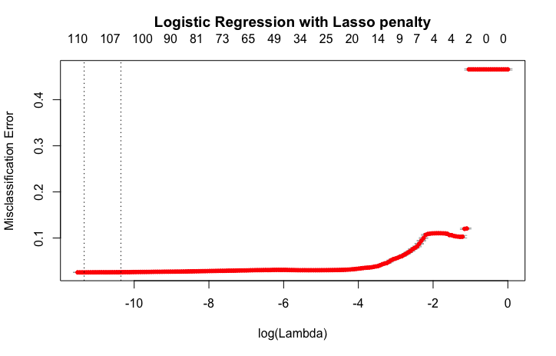
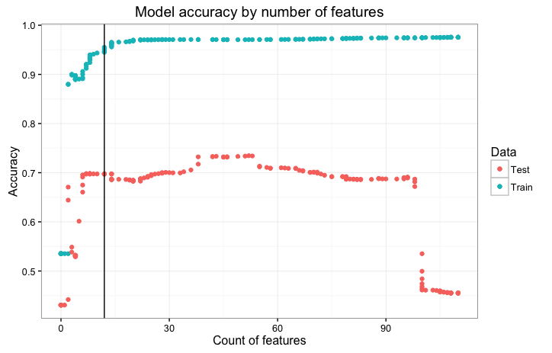
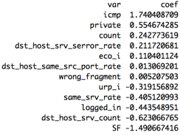
Logistic Regression with Lasso penalty
Split Train 70%/30% then 10-fold CV for lambda:
Balance accuracy and complexity:
12
-3
12
Retained features and coefficients:
Model performance:
69.78% accuracy in test vs 94.48% in train!
48.35% true positive rate
1.89% false positive rate
Why such a large discrepancy in train vs test accuracy?

Slide 10
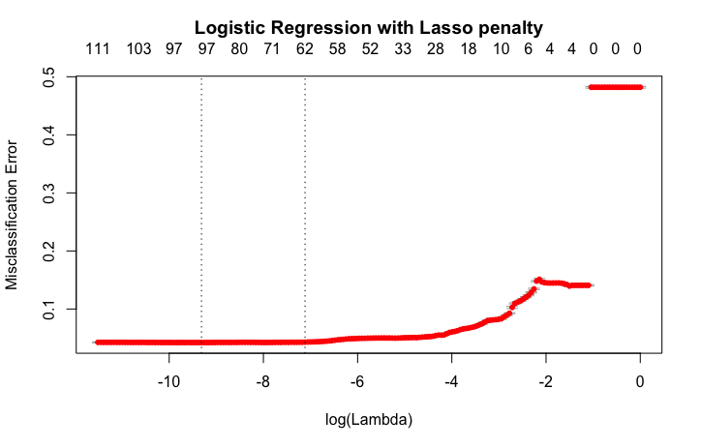
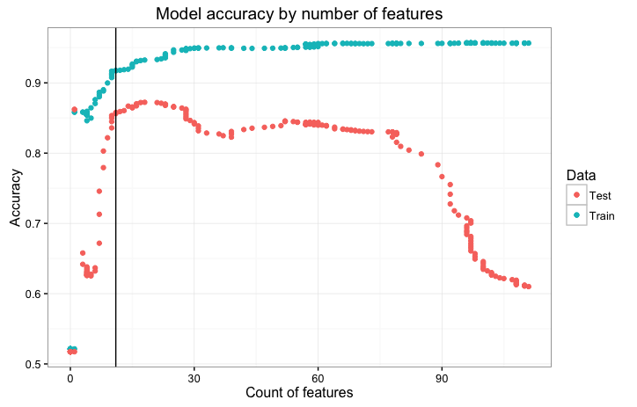
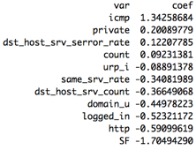
Logistic Regression with Lasso penalty - Shuffled
What happens if we combine, resample and re-split Train and Test datasets?
Split Train 70%/30% then 10-fold CV for lambda:
Balance accuracy and complexity:
11
-3
11
Retained features and coefficients:
Model performance:
85.63% accuracy in test vs 91.72% in train!
72.83% true positive rate
2.43% false positive rate
Is there underlying bias in the test data? Let’s try other algorithms first

Slide 11
Naive Bayes
Unshuffled Train and Test data:
Parameters:
70/30 split; 10-fold CV
Laplace = 1
Accuracy:
Train: 89.35%
Test: 77.80%
True positive rate: 91.75%
False positive rate: 32.14%
Shuffled Train and Test data:
Parameters:
70/30 split; 10-fold CV
Laplace = 1
Accuracy:
Train: 87.96%
Test: 87.42%
True positive rate: 86.53%
False positive rate: 11.74%
Again, shuffling the train/test data leads to more aligned train and test accuracy

Slide 12
Random Forest
Unshuffled Train and Test data:
Parameters:
mtry: 15
# of trees: 500
Accuracy:
Train OOB error: 0.001
Test accuracy: 77.21%
True positive rate: 61.97%
False positive rate: 2.66%
Shuffled Train and Test data:
Parameters:
mtry: 15
# of trees: 500
Accuracy:
Train OOB Error: 0.003
Test accuracy: 99.71%
True positive rate: 99.59%
False positive rate: 0.18%
Again, shuffling the train/test data leads to more aligned train and test accuracy

Slide 13
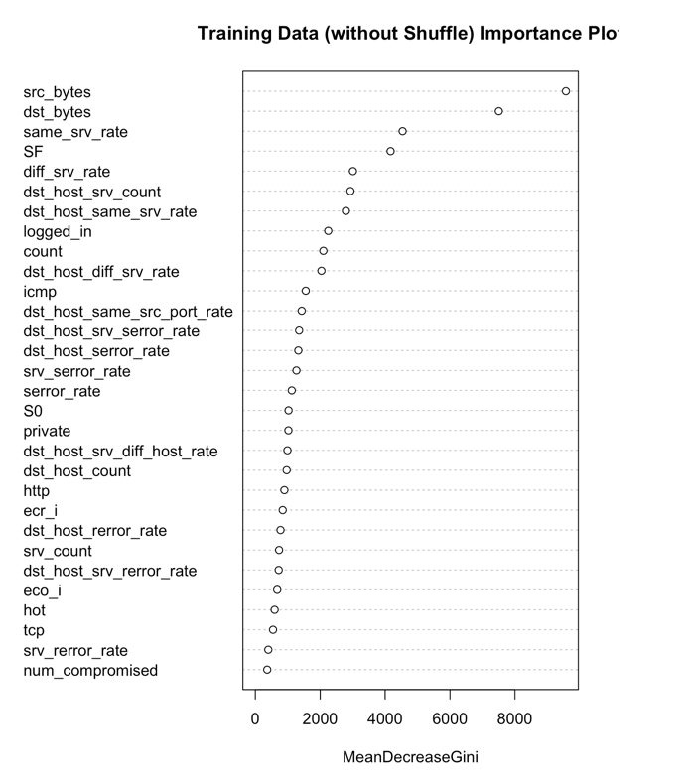
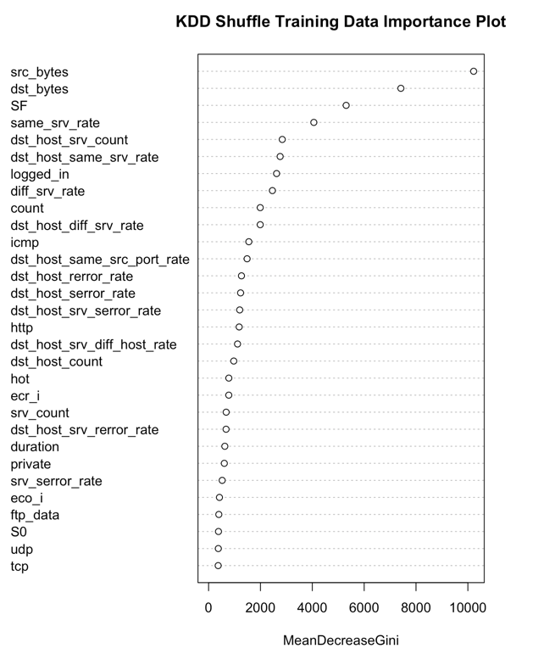
Random Forest - Variable Importance

Slide 14
Xgboost
Unshuffled Train and Test data:
Parameters:
eta: 0.02
max_depth: 5
Accuracy:
Train: 99.79%
Test: 76.94%
True positive rate: 61.57%
False positive rate: 2.75%
Shuffled Train and Test data:
Parameters:
eta : 0.02
max_depth: 5
Accuracy:
Train: 99.03%
Test: 99.24%
True positive rate: 99.06%
False positive rate: 0.60%
Again, shuffling the train/test data leads to more aligned train and test accuracy

Slide 15
Adaboost
Unshuffled Train and Test data:
Parameters:
nu (shrinkage parameter): 1
iter: 50
Accuracy:
Train: 99.90%
Test: 78.11%
True positive rate: 63.65%
False positive rate: 2.77%
Shuffled Train and Test data:
Parameters:
nu: 1
iter: 50
Accuracy:
Train: 96.60%
Test: 96.82%
True positive rate: 93.71%
False positive rate: 0.28%
Again, shuffling the train/test data leads to more aligned train and test accuracy

Slide 16
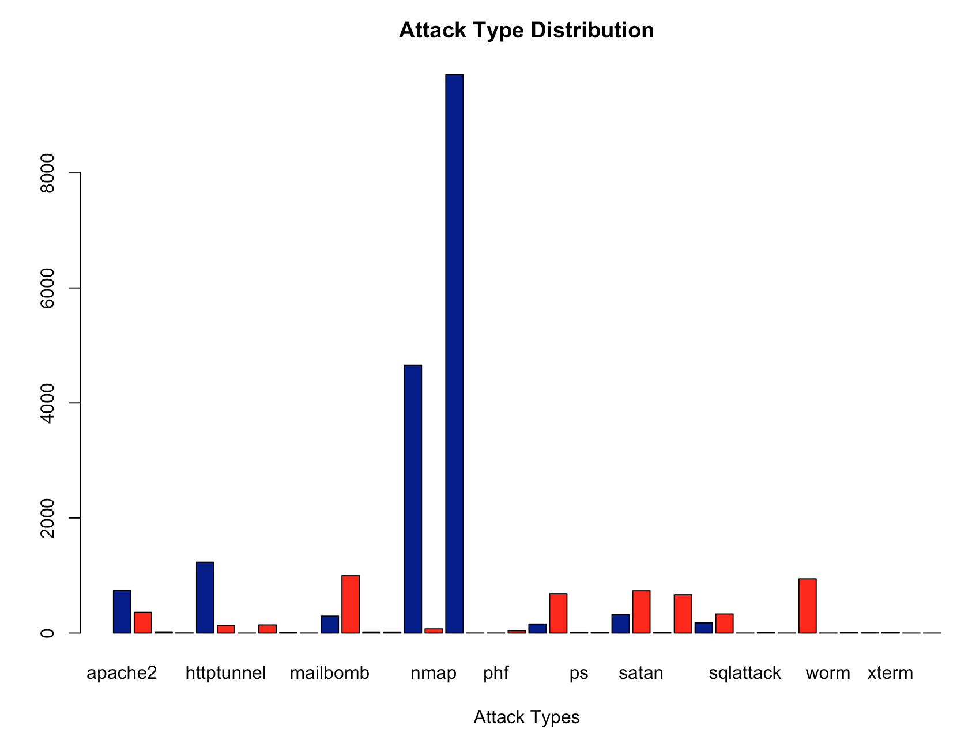
Train vs Test Data
All the algorithms applied thus far have resulted in large discrepancies between train and test accuracy. The true positive rate fluctuates a great deal, suggesting possible bias in the test data set.
Differences between Test and Training Data:
The test data is not from the same probability distribution as the training data. The test data includes specific attack types not in the training data. This makes the task more realistic. The graph below illustrates differences for a subset of these attacks.
Note:
2 attacks in train are not in test
17 in test are not in train
Training
Test
E.g. nmap drastically different between training/test. Training 1493, Test 73
Notes:
Graph with both training and test attack type breakdown
E.g. nmap drastically different between training/test. Training 1493, Test 73;

Slide 17
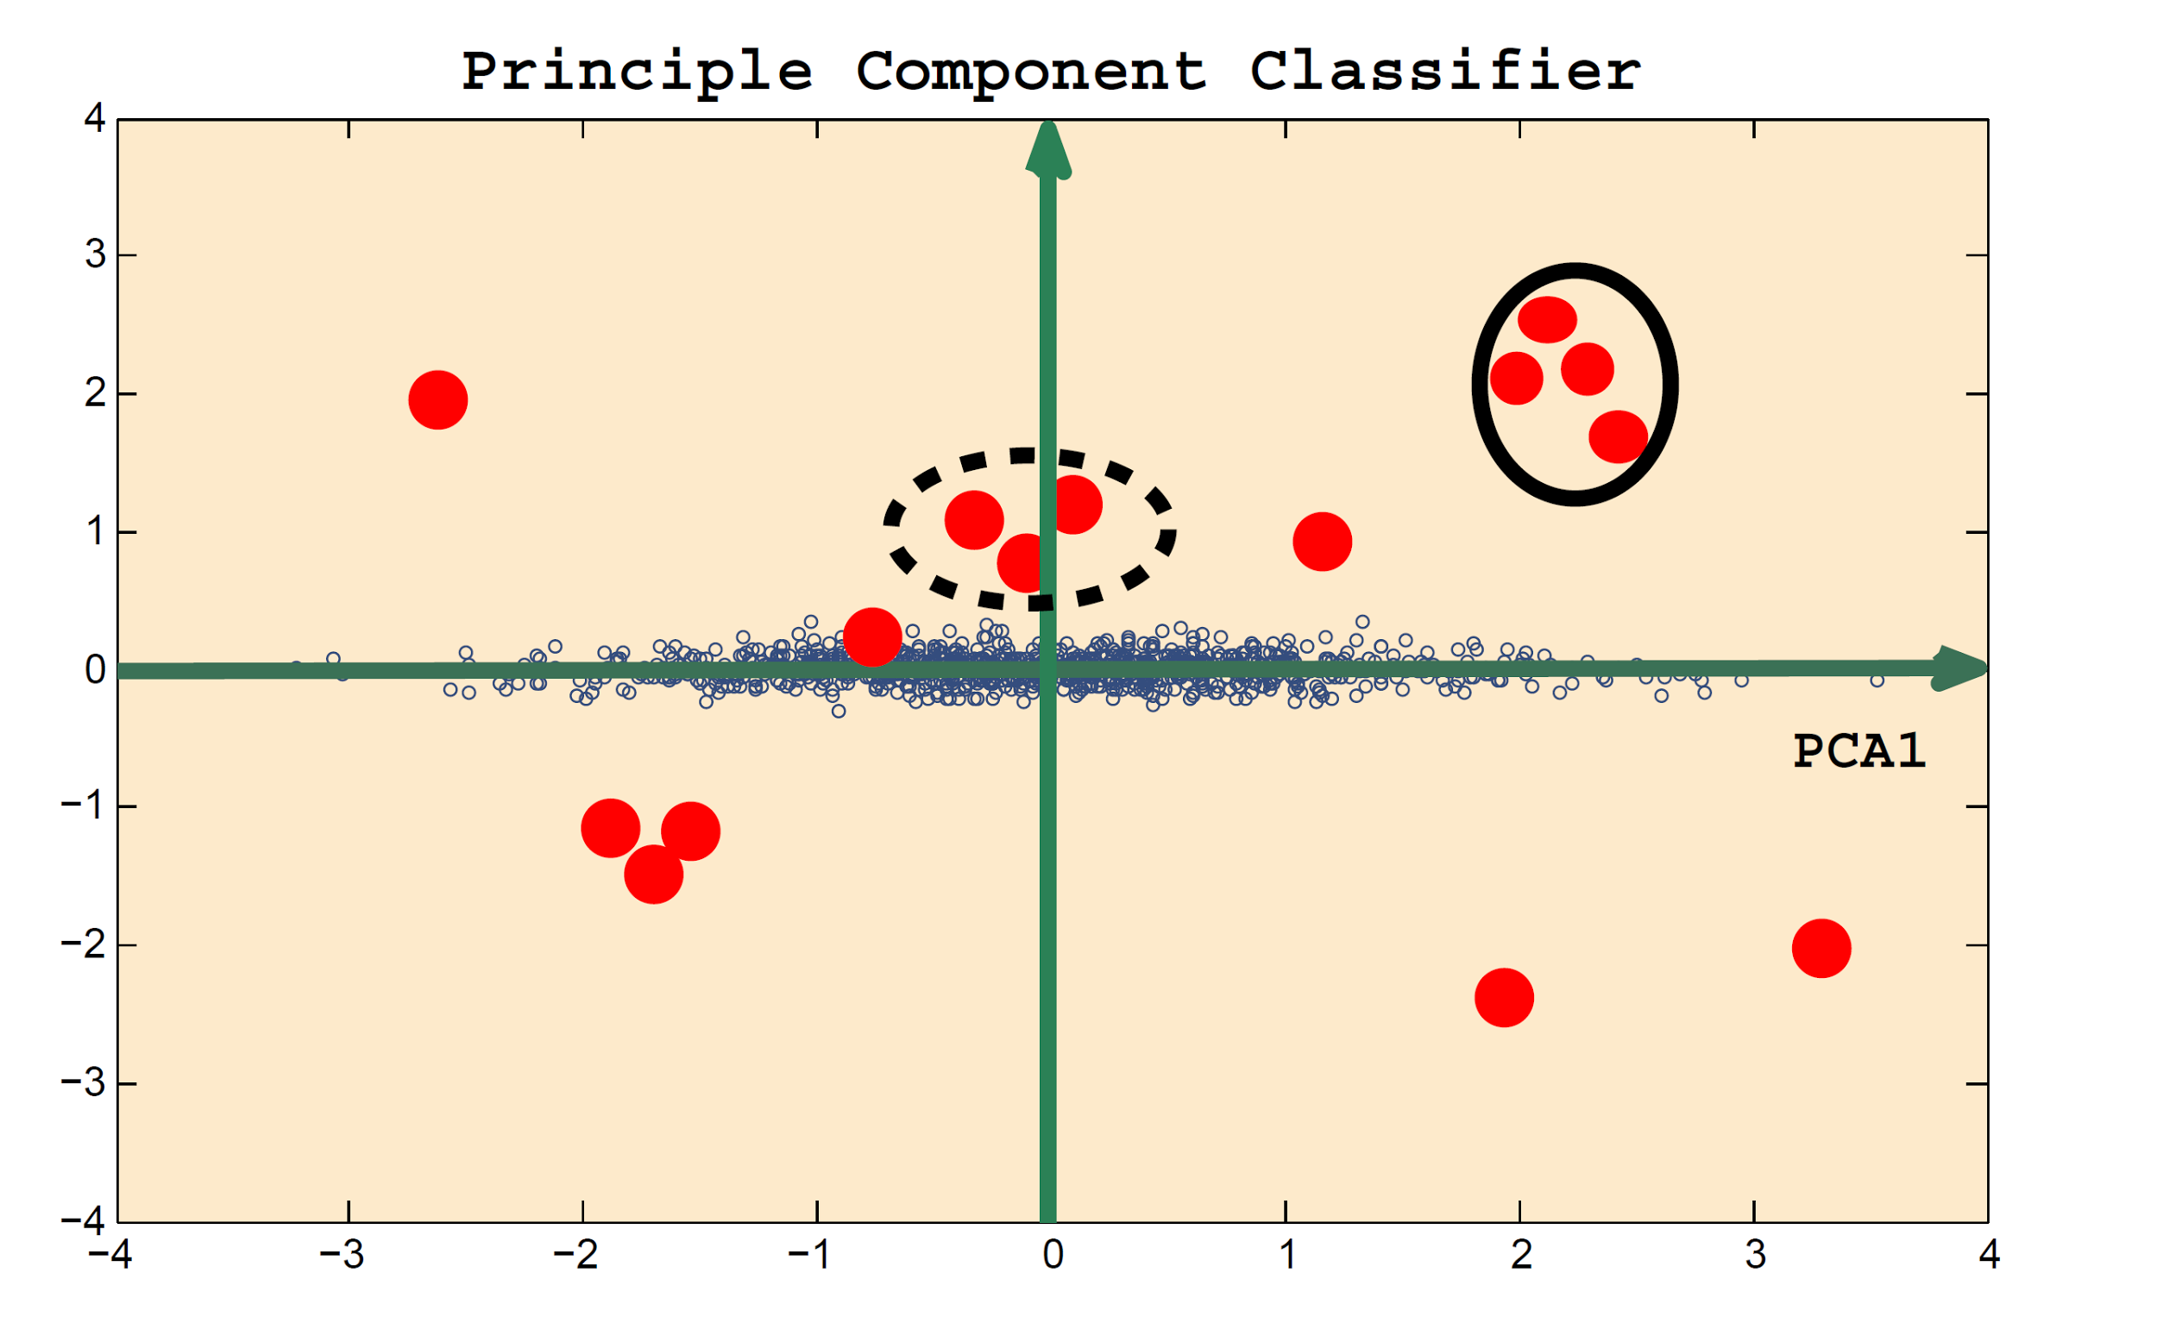
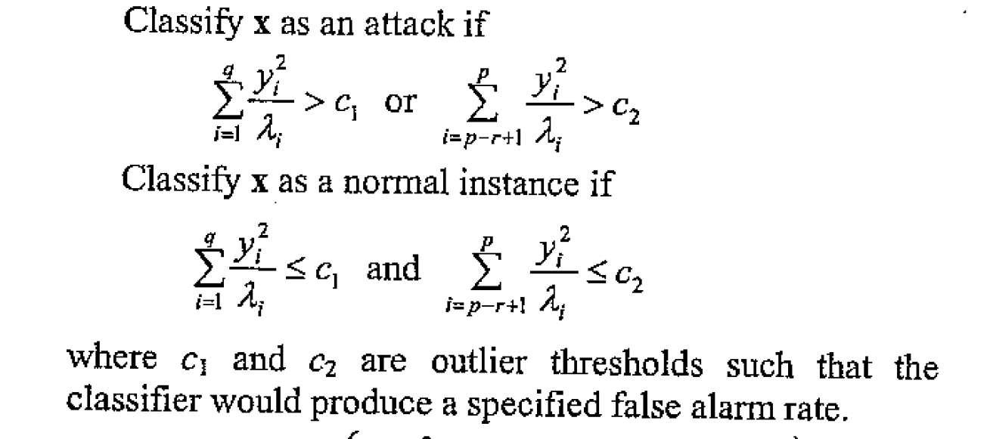
Principal Component Classifier (supervised learning)
PCA2
X1
X2
Ref.: A Novel Anomaly Detection Scheme Based on Principal Component Classifier
NRL Release Number 03-1221.1-2312
Authors: Mei-Ling Shyu, Shu-Ching Chen, Kanoksri Sarinnapakorn, and LiWu Chang

Slide 18
Principal Component Classifier Results
Unshuffled Train and Test data:
Performance on original features:
Accuracy: 80%
True positive rate: 92%
False positive rate: 29%
Performance after adding predicted probabilities from logistic regression:
Accuracy: 83%
True positive rate: 92%
False positive rate: 13%
Shuffled Train and Test data:
Performance on original features:
Accuracy: 90%
True positive rate: 90%
False positive rate: 25%

Slide 19
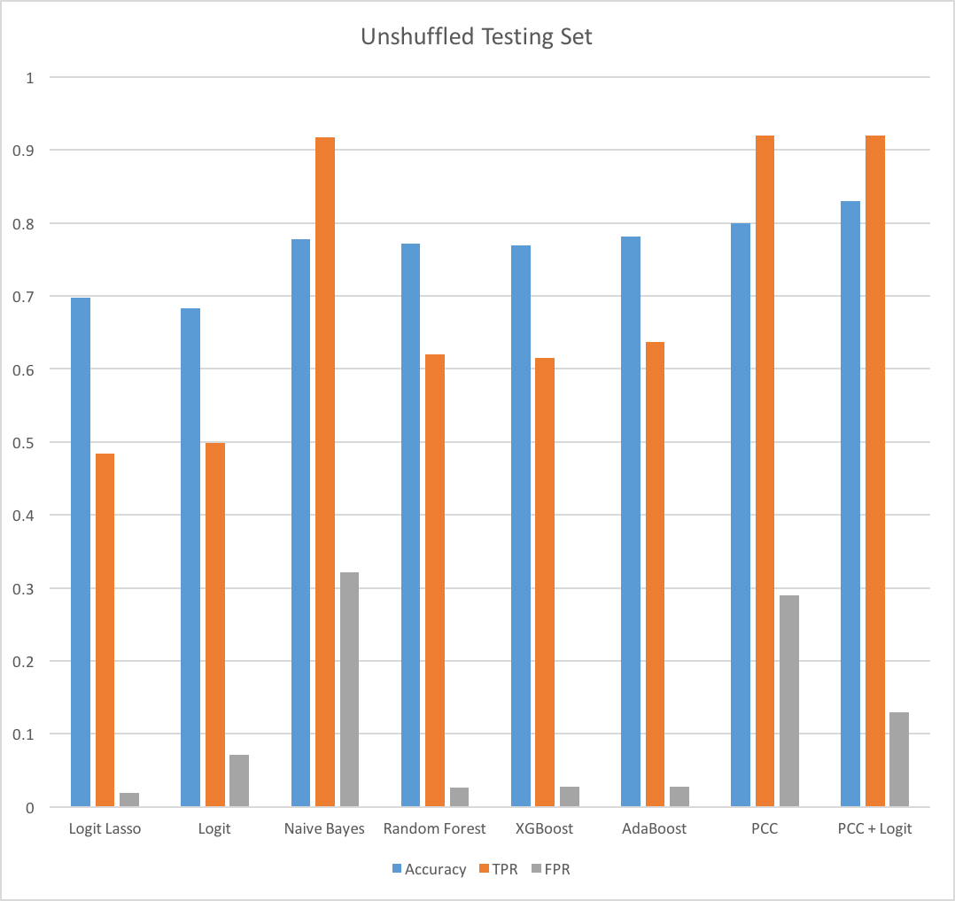
Model Comparison
Note:
TPR: True Positive Rate (higher is better)
FPR: False Positive Rate (lower is better)

Slide 20
Conclusion
After shuffling training and test datasets, all models perform dramatically better. However, this approach is flawed as new, unknown attacks are routinely encountered in real-world scenarios
Basic PCC and naive Bayes models outperform others used in this analysis, especially when new attack patterns are not present in the training dataset
Further development of PCC and naive Bayes models could lead to even better model performance for anomaly detection

Slide 21
Appendices

Slide 22
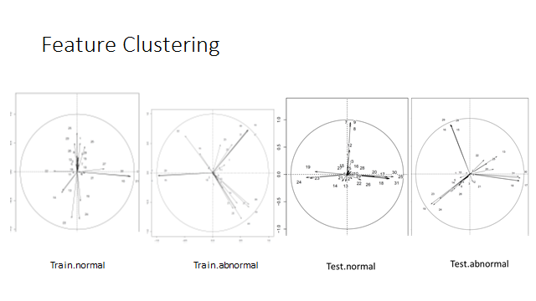
Appendix - PCC Feature Clustering

Slide 23
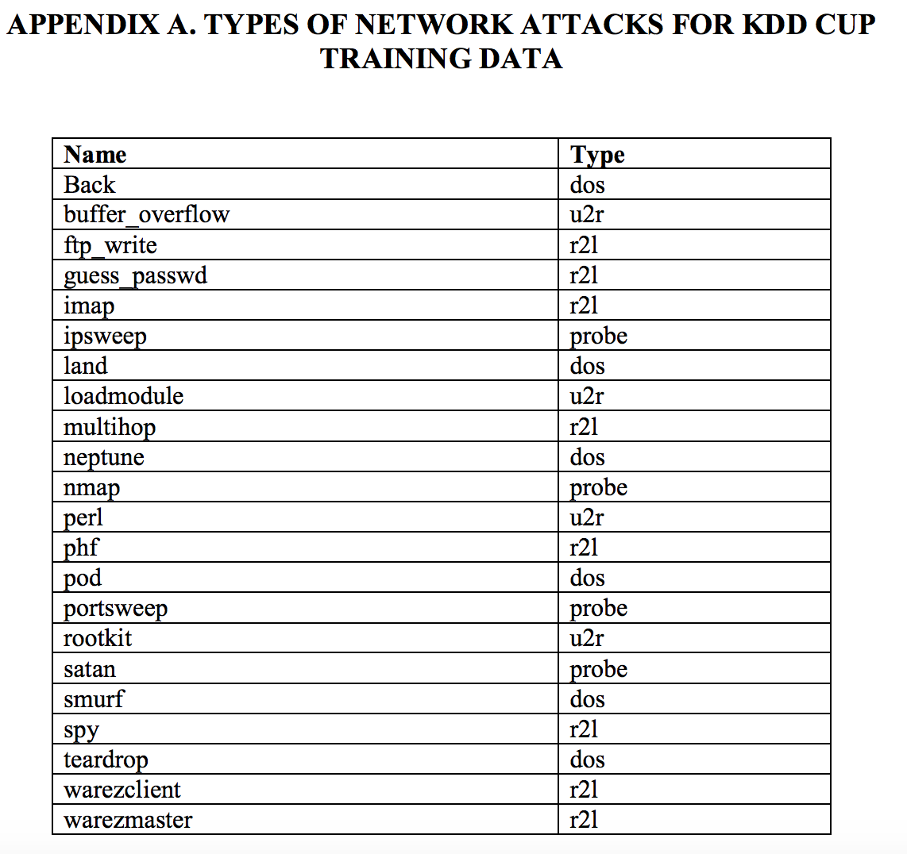
Appendix - Network attack types

Slide 24
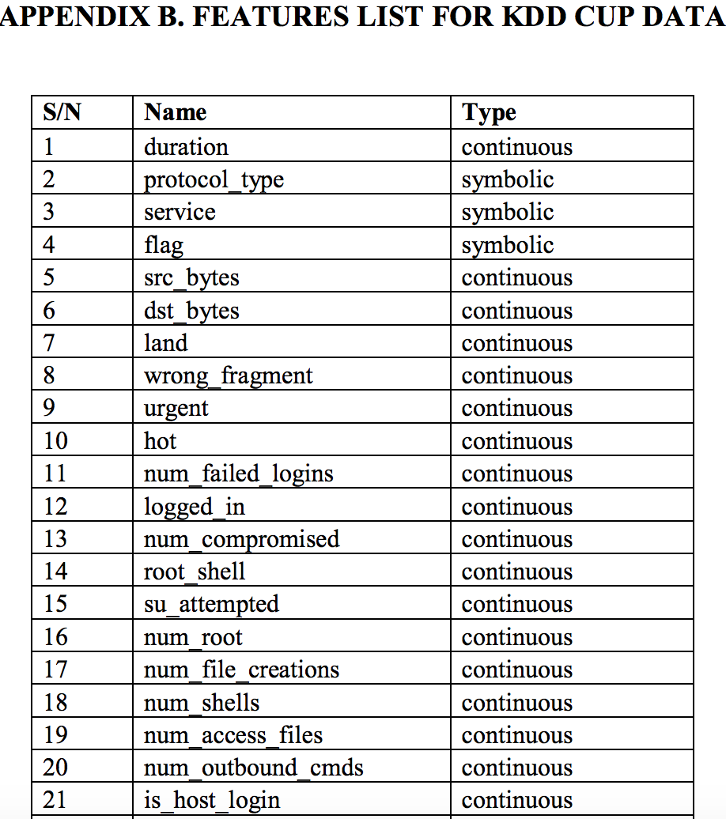
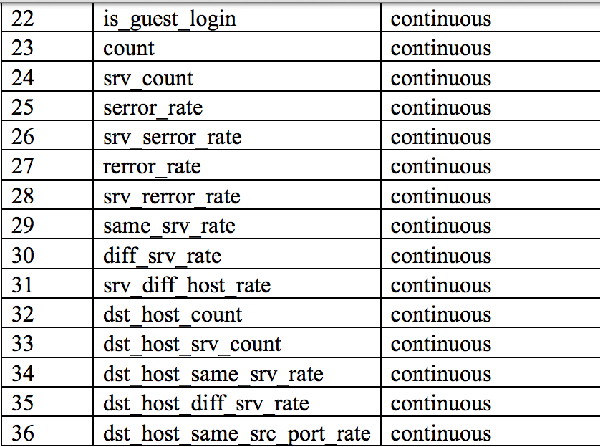
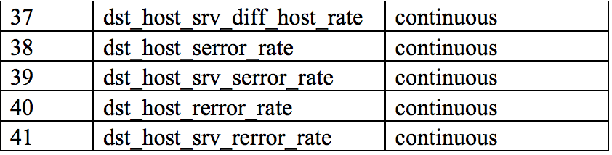
Appendix - List of features

Slide 25
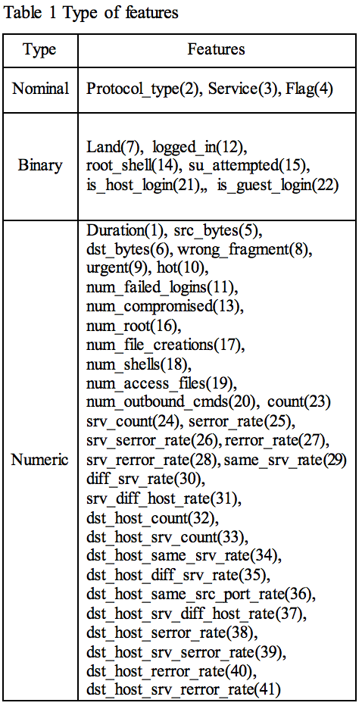
Appendix - Type of features

Slide 26
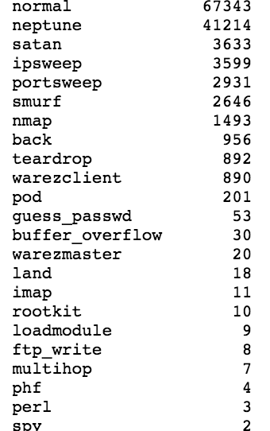
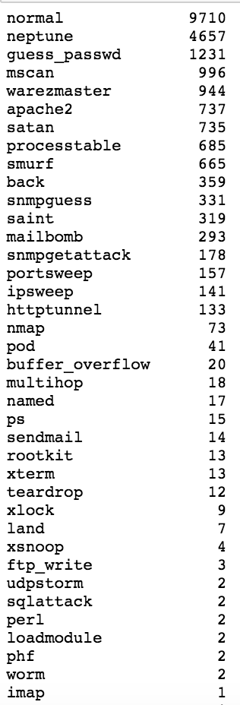
Appendix - Training and Test Variables
Training
Test

Slide 27
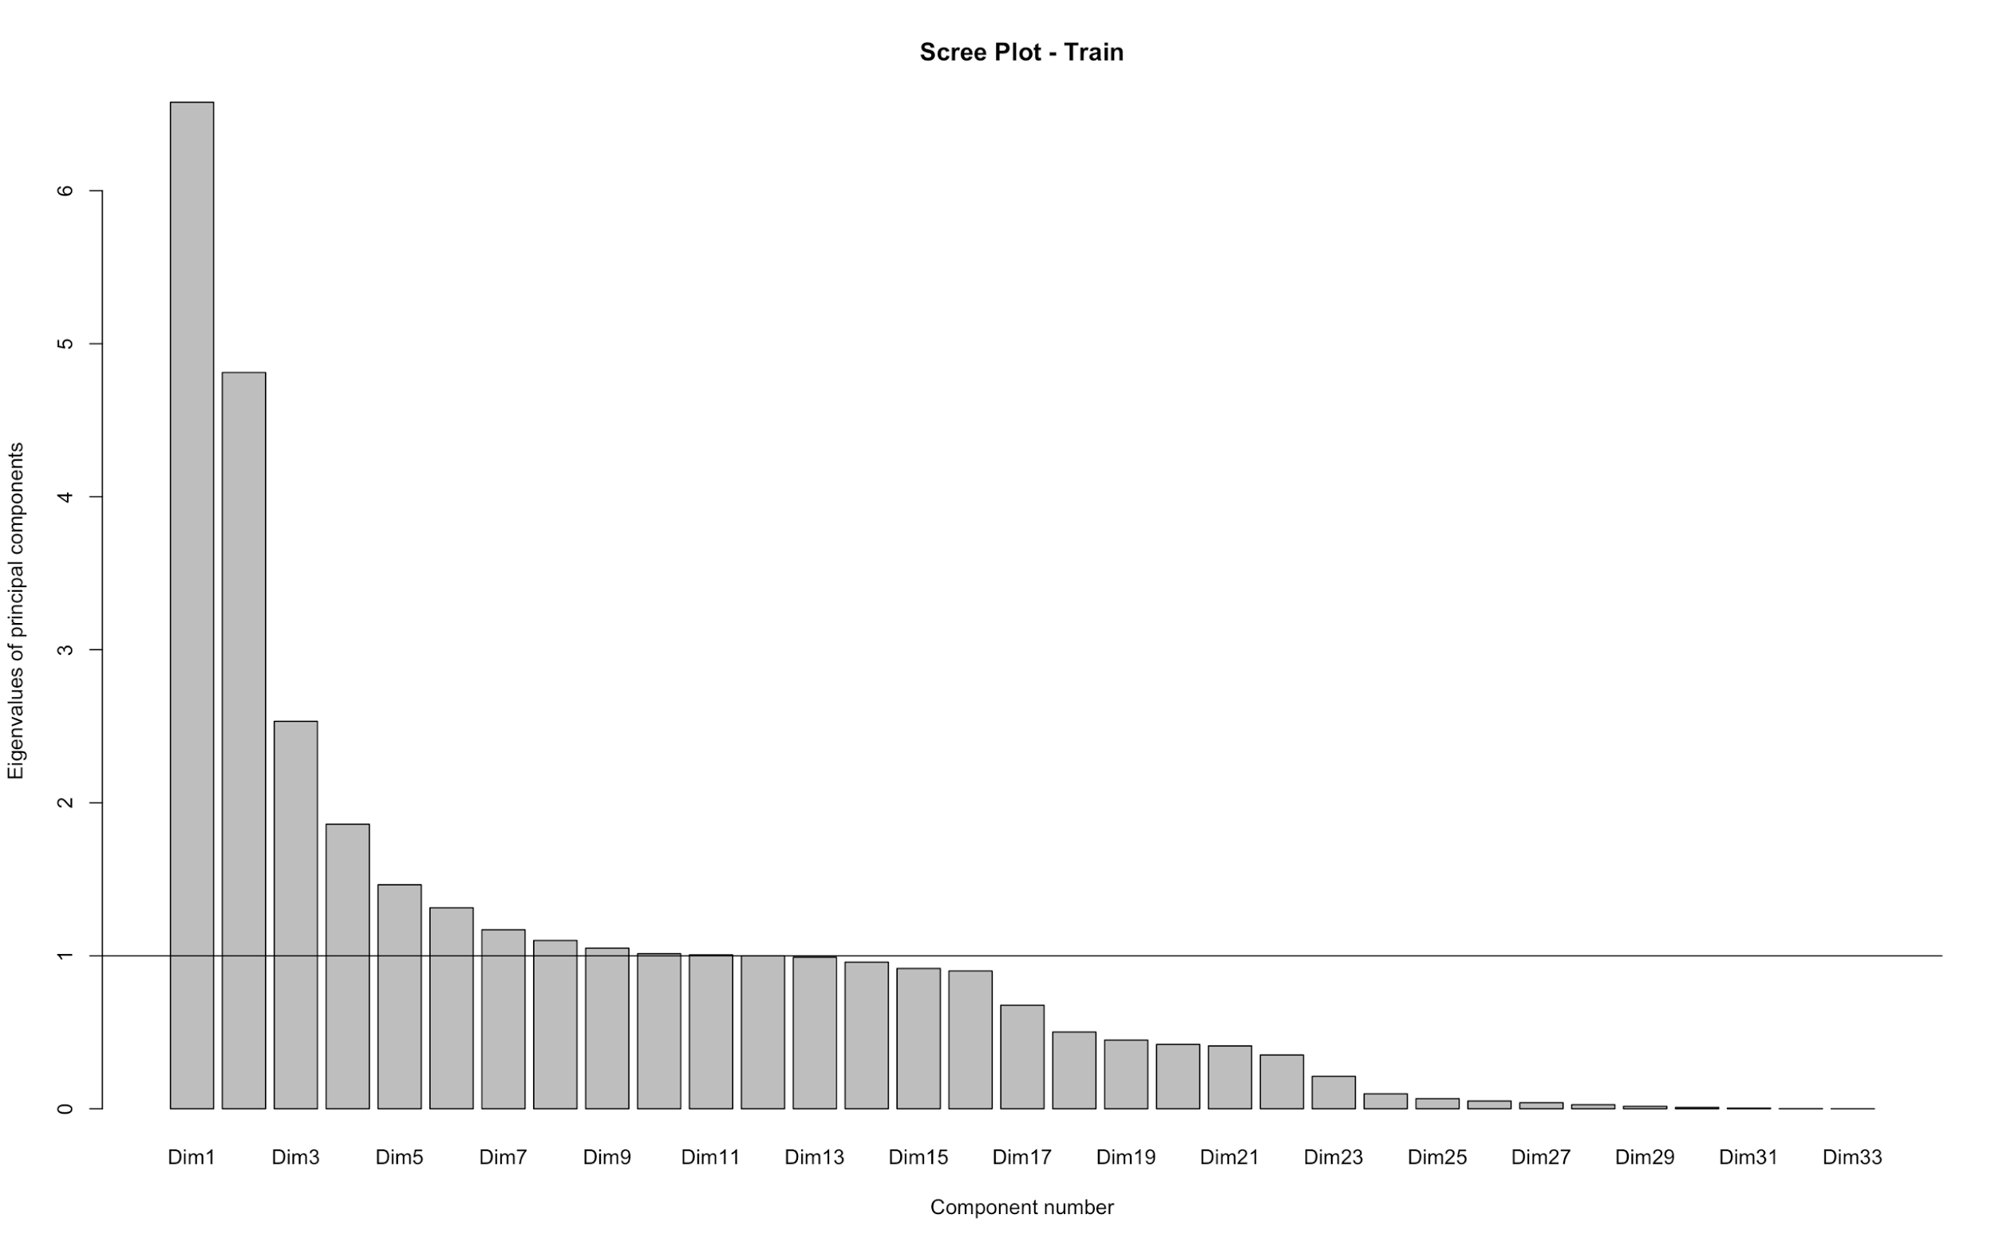
Appendix - PCA eigenvectors
We conducted Principal Component Analysis on the continuous variables in the training dataset:

Slide 28
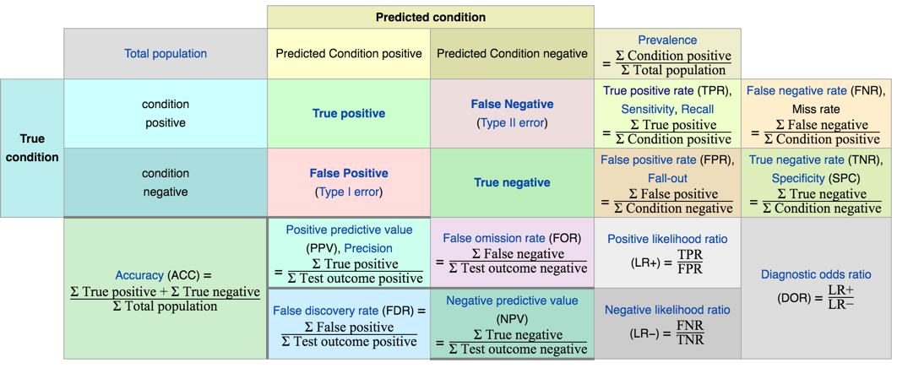
Appendix - Confusion Matrix Reference
From Source.

